Slide 1

VISHWAKARMA INSTITUTE OF INFORMATION TECHNOLOGY, PUNE
BE PROJECT
Guide : Mrs. Priyanka More Ma’am
Members : Raj Shah 17u193
Shriya Chivate 17u544
Suhani Chandolikar 17u539
Tasneem Chopdawala 17u327
Project Group : TY-COMP/PRJ/19-20/1

Slide 2
HEALTHCARE CHATBOT Using Machine Learning Technologies

Slide 3
01
About The Company
Proost Solutions Pvt Ltd

Slide 4
Company - Proost Solution Pvt Ltd Product - DrPrax
Proost Solutions aim at building a platform that will allow
a connected healthcare system of providers and patients. Their main aim is to empower Healthcare Specialists with a simple & intuitive digital medium for making qualitative use of their time and knowledge for their existing and new patients. Given the nature of changing lifestyle and adoption of the digital medium Proost solutions aim at smartphone-based interaction that will change the way specialist providers will engage with urban and rural patients soon. With this in mind, Proost Solutions have launched a product called DrPrax which is a healthcare app focused on enabling better remote communication between patients & their doctors/specialists thereby fostering stronger doctor-patient relationships.
Team: Vinita Navadgi, Founder
Atul Shah, Founder
Gururaj Phadnis, VP Engineering

Slide 5
02
OBJECTIVE

Slide 6
OBJECTIVE
The objective of the project is to build a chatbot that can predict diseases and provide information of the disease as well as nearby hospitals or online consultation.
Save the efforts of getting unnecessary checkups.
Interactive and easy chatbot.
Provide accurate prediction of diseases.

Slide 7
03
MOTIVATION

Slide 8
MOTIVATION
At present, when someone suffers from a particular disease, they have to visit a doctor, which is time-consuming and costly. If the user is out of reach of doctors and hospitals it may be difficult for the user as the disease cannot be identified. So, if the above process can be completed using an automated program which can save time as well as money, it can be very helpful to the user and can make the process easier.
The aim of Disease prediction is to predict the disease of patient provides the symptoms. As there is advancements in digital technology the use of internet is at pace, people are curious towards new things and ask the web. People have access to the internet faster than hospitals and doctors.
So, this system can be helpful to people to know how serious their symptoms are and which doctor they need to go to.

Slide 9
04
PROJECT SCOPE

Slide 10
PROJECT SCOPE
This project aims to provide a web platform to predict the occurrences of disease based on various symptoms.
The user can type in their symptoms, answer a few questions and find the probable disease with some immediate suggestions as well as which doctor, they should refer to.
They can also check nearby hospitals.

Slide 11
05
METHODOLOGY

Slide 12
METHODOLOGY OF PROMLEM SOLVING
Development of Machine Learning Based chatbots is becoming popular and easier for software developers using Dialogflow. Developers can use it to make interfaces (e.g. Chatbots) that are capable of natural and rich interactions between users and businesses. It is powered by machine learning to perceive the intent and context of what a user says, allowing the conversational interface to produce highly efficient and accurate responses. Thus, we are implementing our chatbot using Dialogflow.
Disease Prediction has been already implemented using different techniques like Neural Network, the Naive Bayes algorithm, etc. From the analysis, it was found that the Decision Tree is more accurate than other techniques.
Kommunicate provides customized User interface for the chatbot. Kommunicate was being integrated with React js

Slide 13
06
SYSTEM DIAGRAM

Slide 14
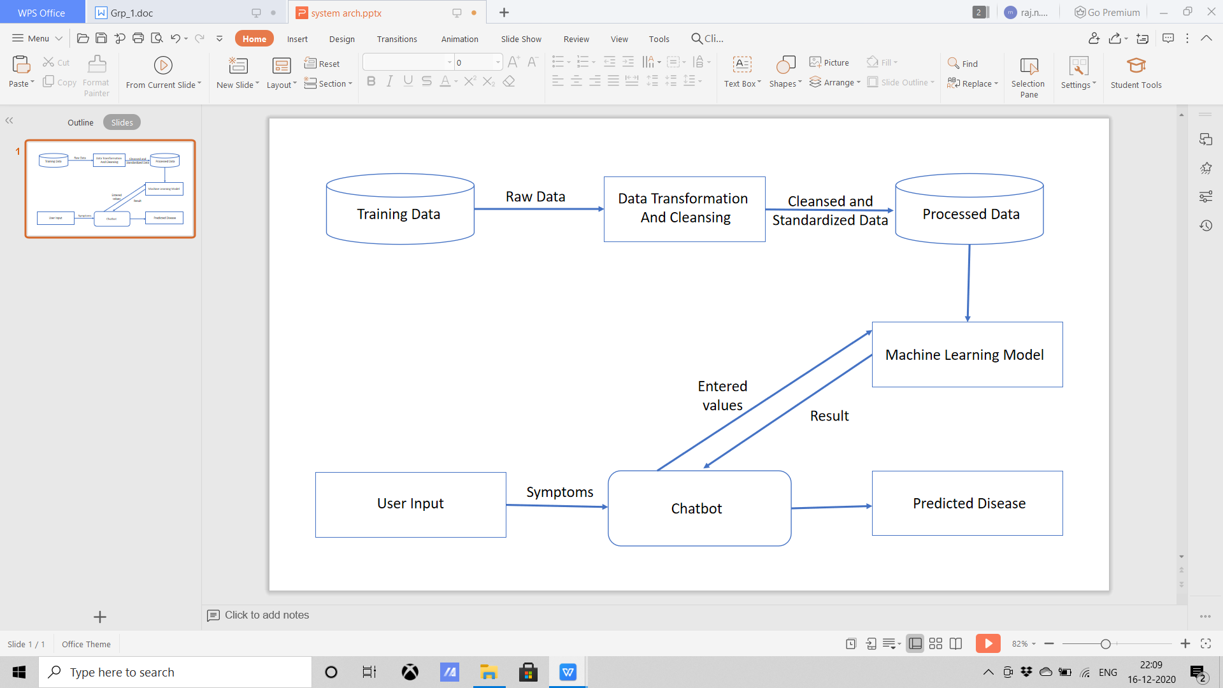
SYSTEM ARCHITECTURE

Slide 15
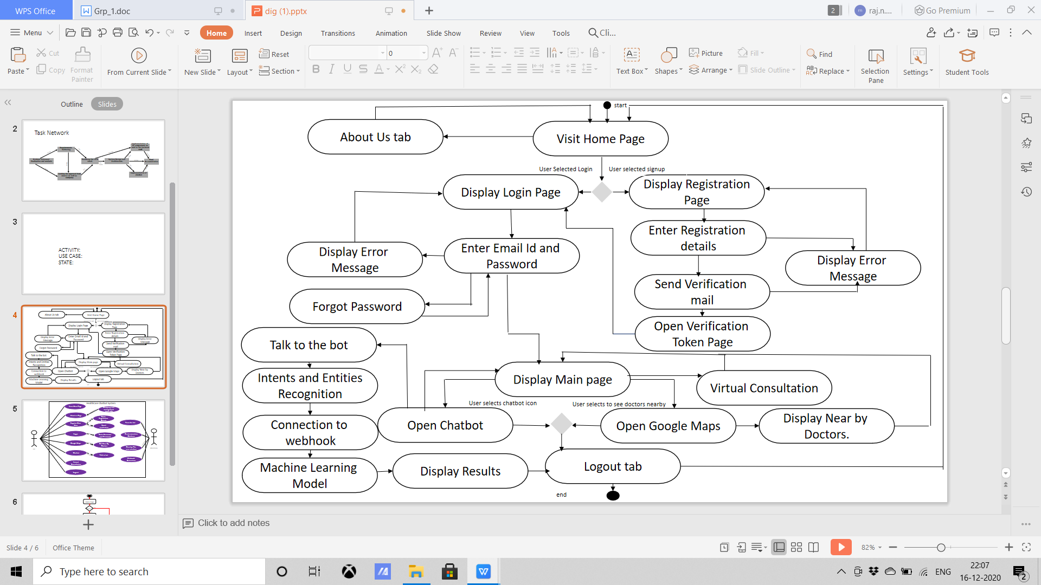
ACTIVITY DIAGRAM

Slide 16
07
TECHNOLOGY REQUIREMENTS

Slide 17
TECHNOLOGY STACK
TOOLS
React Js for the front end
Kommunicate for chatbot customized UI
Dialogflow for building chatbot
Nodejs for backend
Python(flask) for connecting webhook
Webhook
MongoDB as Database
Google Maps API
Mailgun API
API

Slide 18
08
TIMELINE

Slide 19
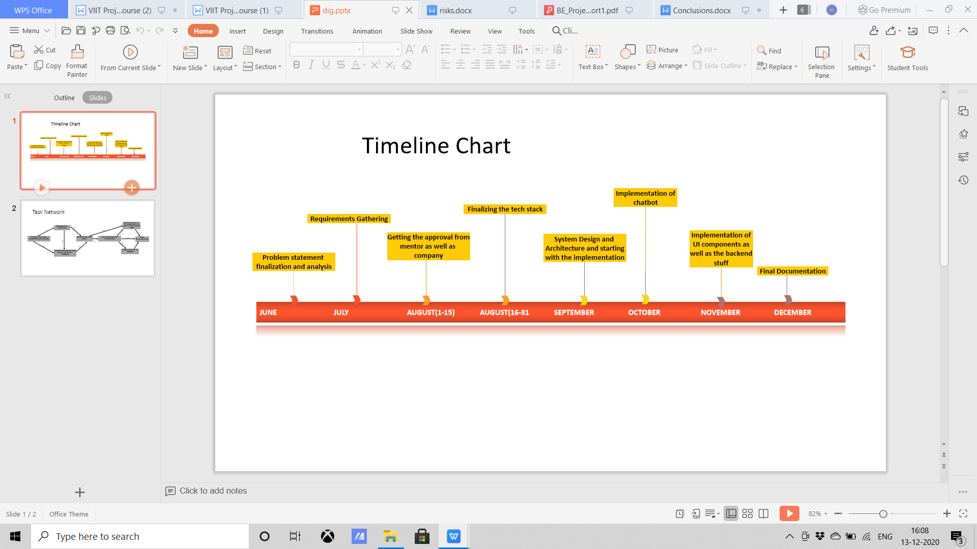
TIMELINE

Slide 20
09
IMPLEMENTATION

Slide 21
PROJECT IMPLEMENTATION
Symptom Extraction
Diagnosis of Symptoms

Slide 22
DECISION TREE ALGORITHM
Supervised learning technique which is used for both classification and Regression problems, but mostly preferred for Classification problems.
Tree where internal nodes represent the features of a dataset, branches represent main decision rules and every leaf node represents the result.
Two nodes, which are the principal decision Node and Leaf Node.
The decisions are performed based on features of the given dataset.
It starts with the foundation node, which expands on further branches and constructs a tree-like structure.
To make a tree, we use the CART algorithm.
A decision tree simply asks a problem and suggests the answer (Yes/No), and then further splits the tree into subtrees.

Slide 23
10
CONCLUSION

Slide 24
CONCLUSION
As the field of Healthcare is moving towards AI technology, Machine learning is now being adopted into this field and a wide variety of methods are being used for various tasks in the diagnosis of diseases in patients.
We have built a working medical bot that is user friendly who knows how to type in the English language and provides a personalized diagnosis of the user’s health.
It heavily relies on machine learning algorithms as well as the data to train the chatbot and also predict diseases.
Patients get a better understanding before-hand about the disease they might be facing so they could consult doctors and ensure their safety.
The portal also provides the feature of Nearby Hospitals and Virtual consultation.

Slide 25
11
FUTURE SCOPE

Slide 26
FUTURE SCOPE
In the future, the conversational flow can be improved with better APIs.
Given, the disease is predicted accurately, the chat-bot can prescribe medicine to the user.
The database can be improved by adding all sorts of diseases and symptoms to make it easier to use.
Additional details like gender, blood group, hereditary information and the patient's previous medical condition could also be incorporated for the analysis.
Once a user takes the test his/her proper summary can be generated from the results of the test.

Slide 27
12
PROJECT RESULTS

Slide 28
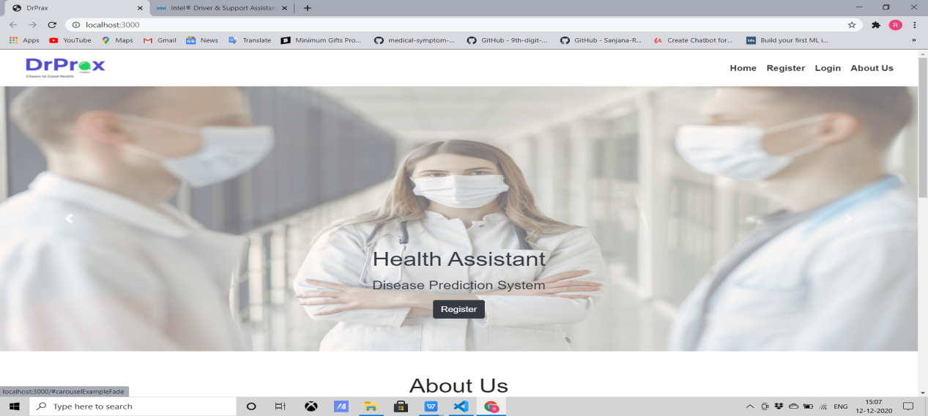
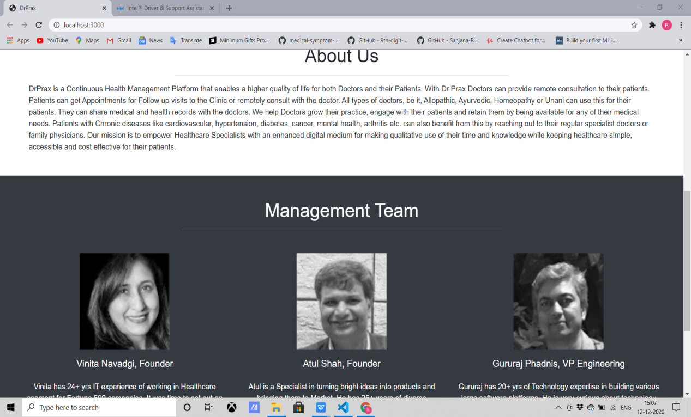
PROJECT RESULTS

Slide 29
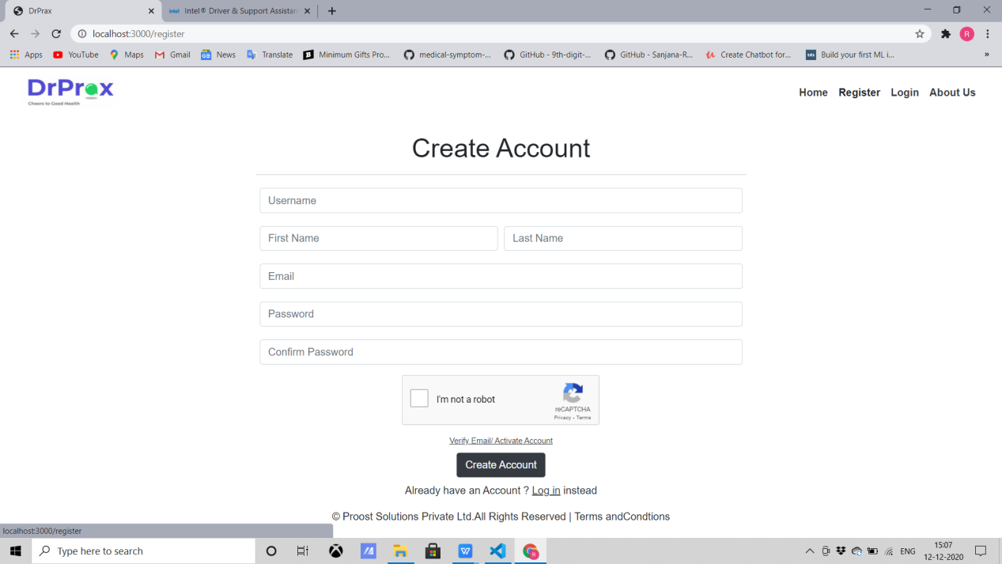
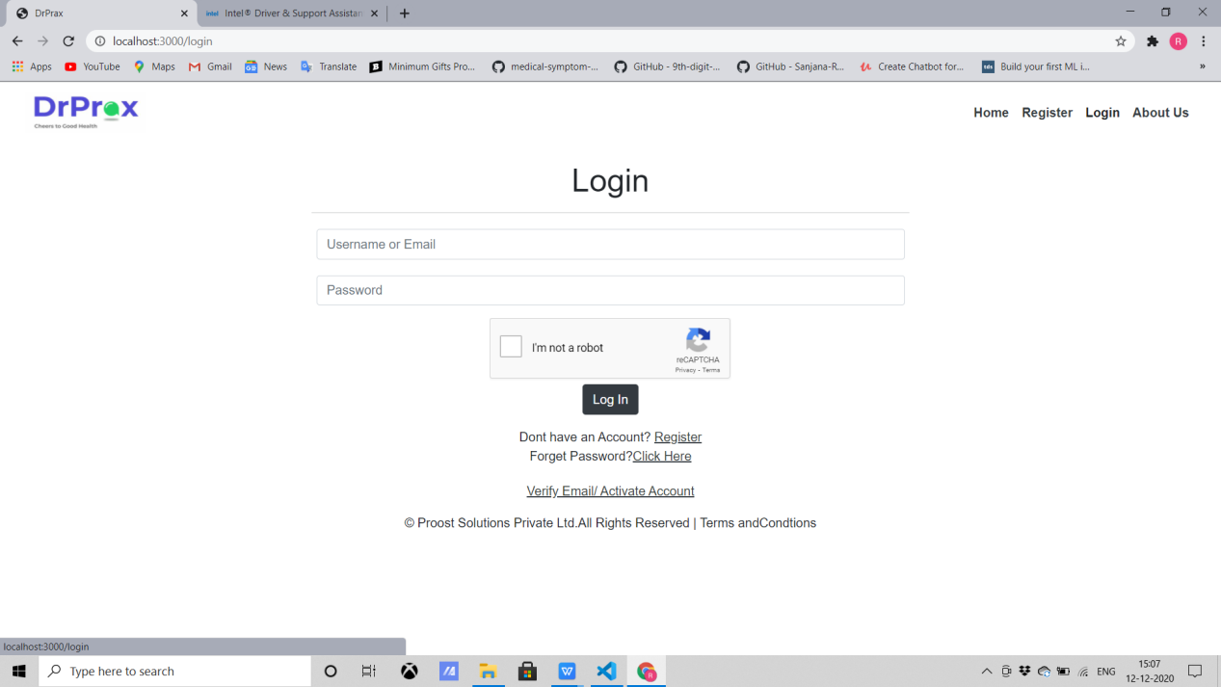
PROJECT RESULTS

Slide 30
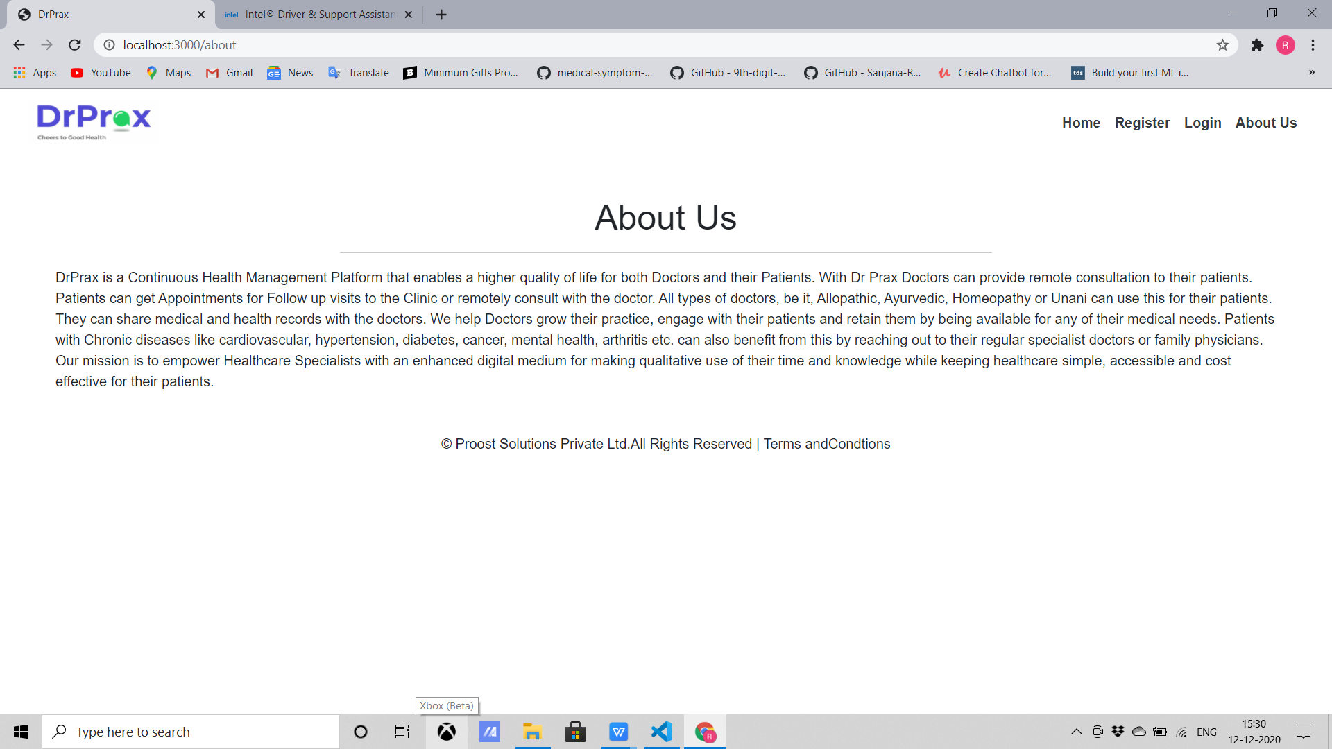
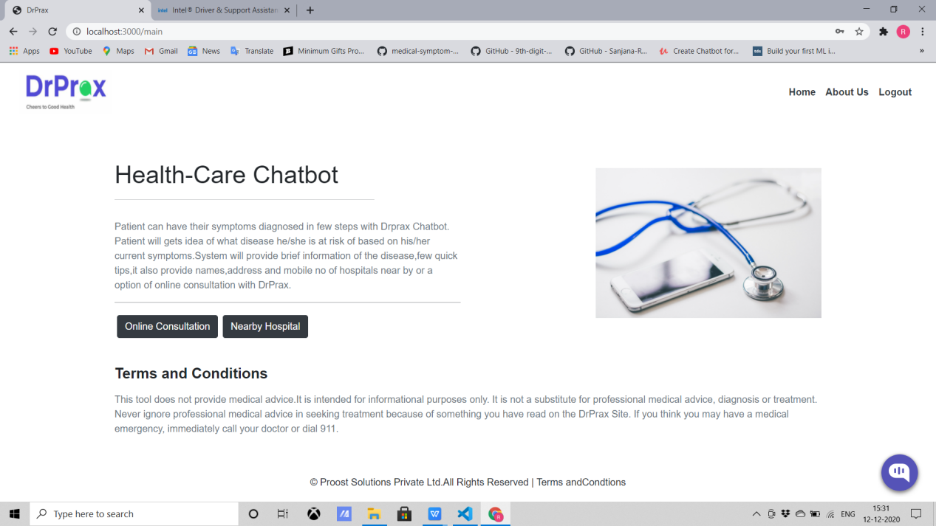
PROJECT RESULTS

Slide 31
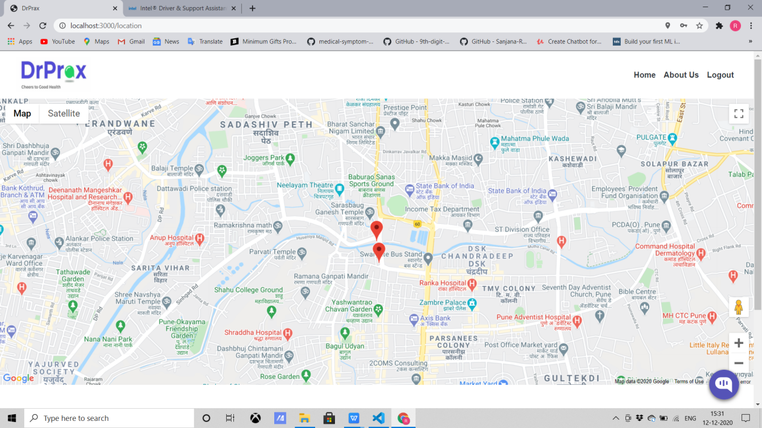
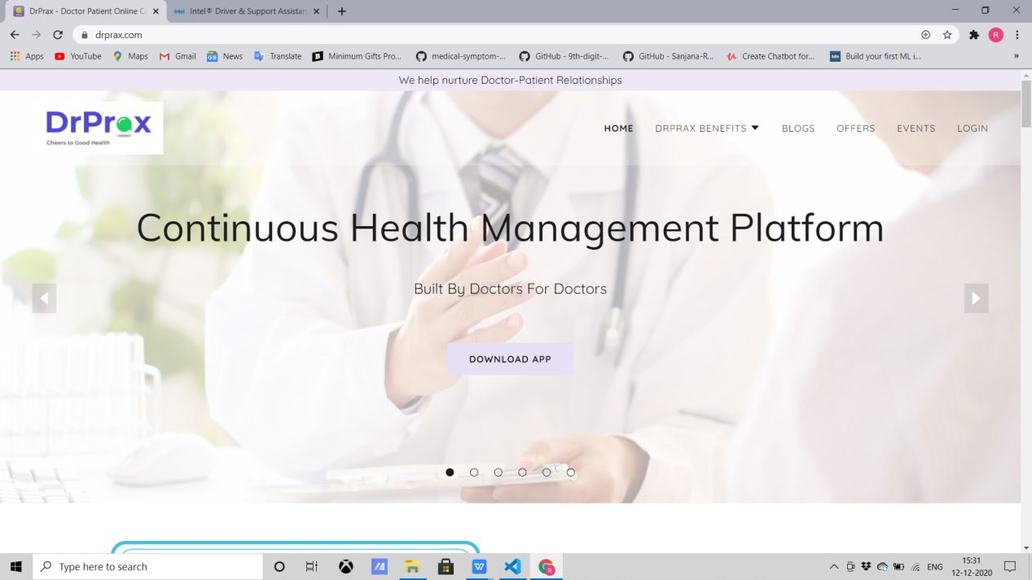
PROJECT RESULTS

Slide 32
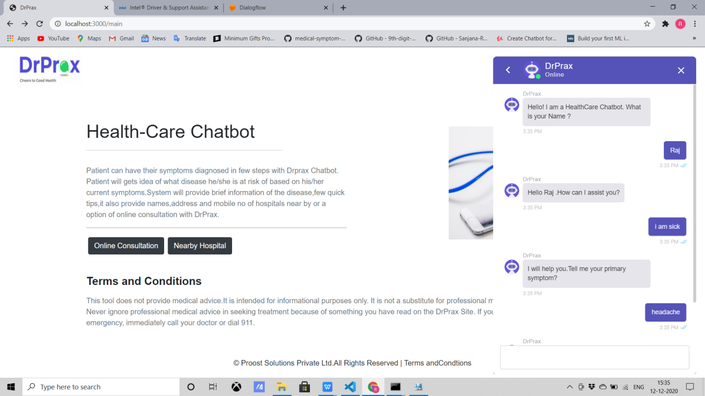
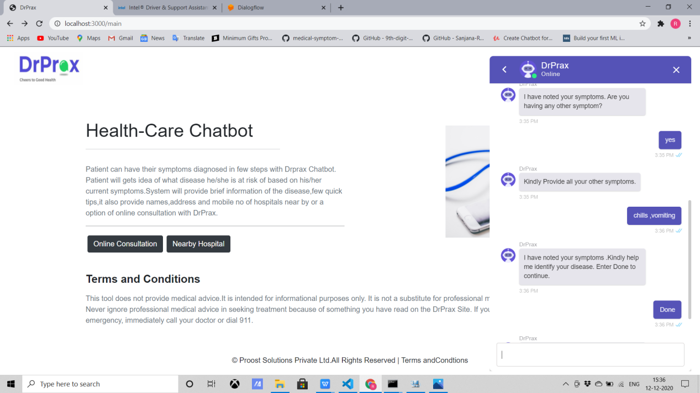
PROJECT RESULTS

Slide 33
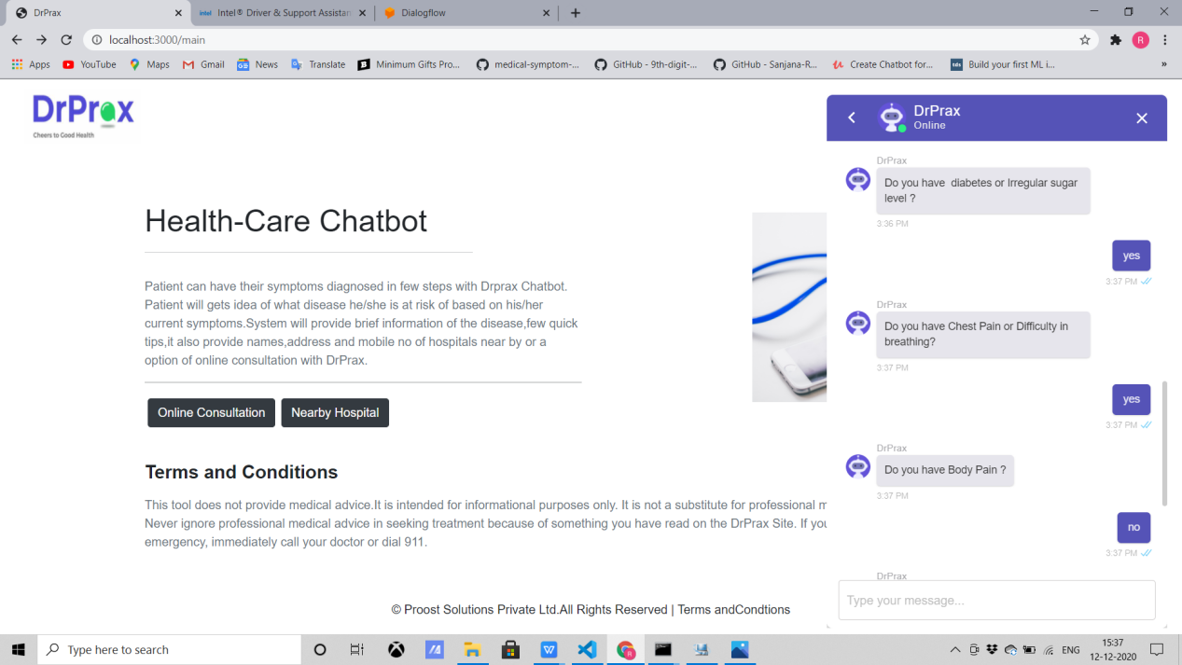
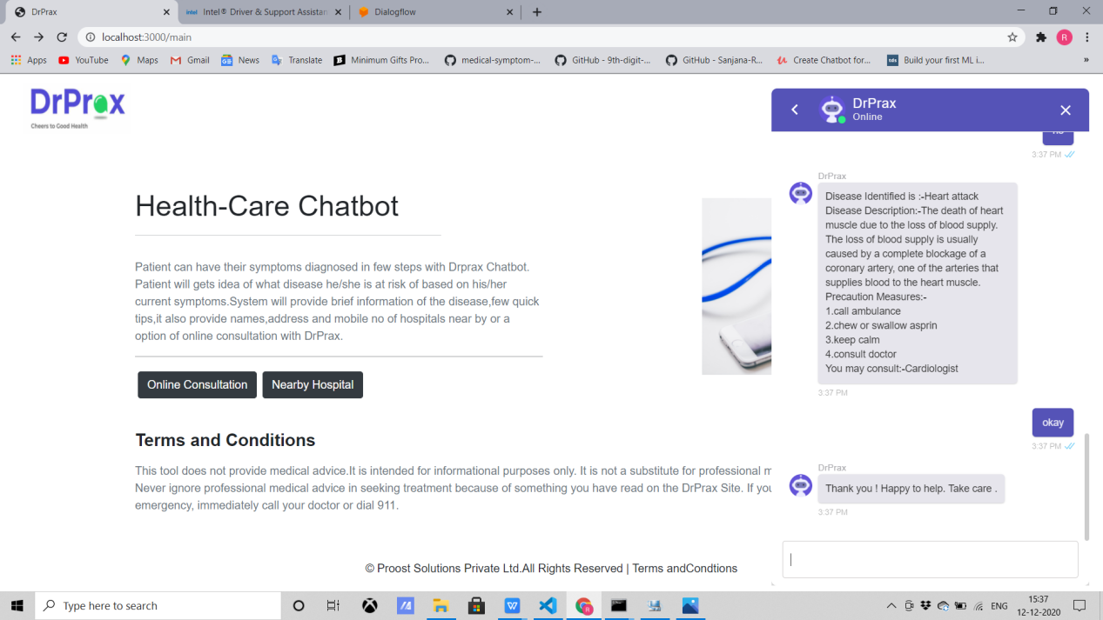
PROJECT RESULTS

Slide 34
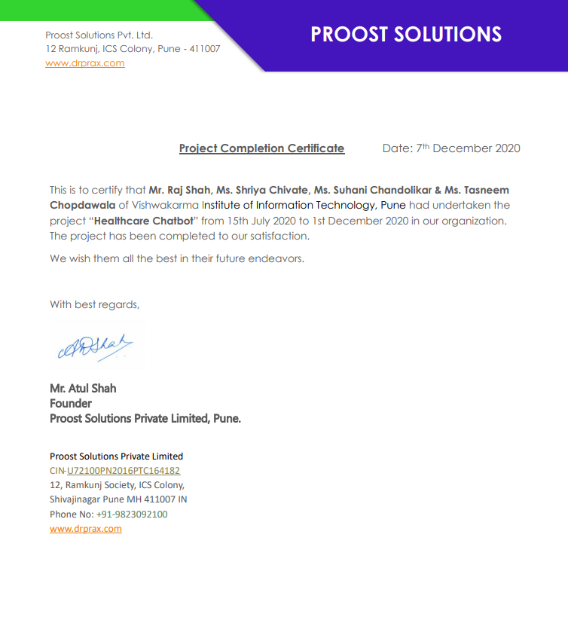
PROJECT COMPLETION CERTIFICATE

Slide 35
THANK YOU

